Slide 1
Module 2: Mechanical Separations (Chapter 29)
Lecture 5
Somak Chatterjee

Slide 2
Continuous Filtration

Slide 3
Principles of Cake Filtration
Constant-pressure filtration:
  The method in which the pressure drop over the filter is held constant through the run so that the rate of filtration is maximum at the start of filtration and decreases continuously towards the end of the run
Constant-rate filtration:
  The method in which the pressure drop is varied usually from a minimum at the start of filtration to a maximum at the end of filtration.

Slide 4
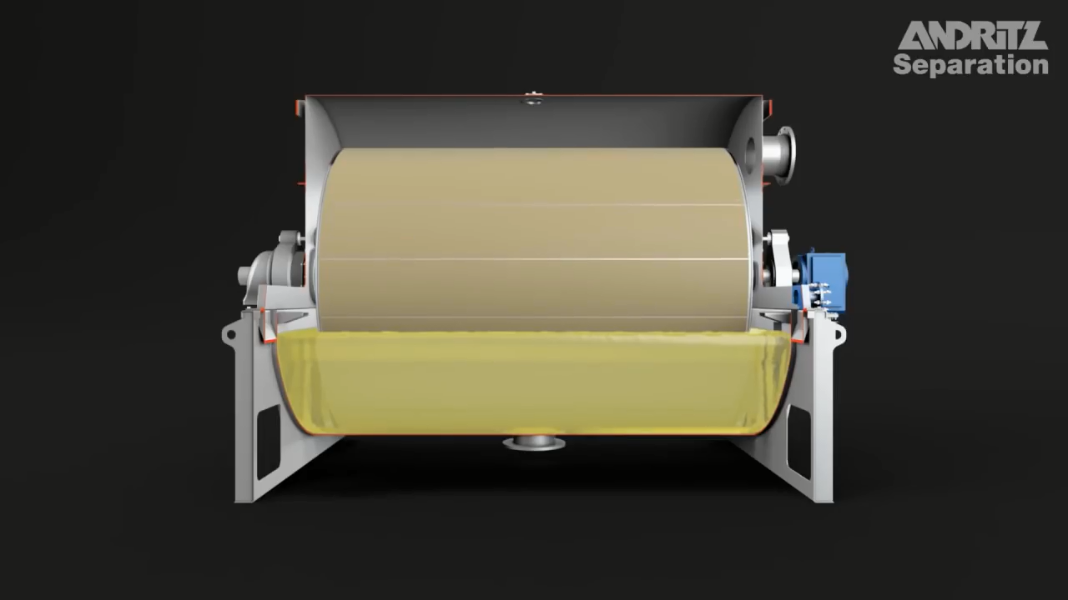
Continuous Filtration
https://www.youtube.com/watch?v=zSflxzE0nIo

Slide 5
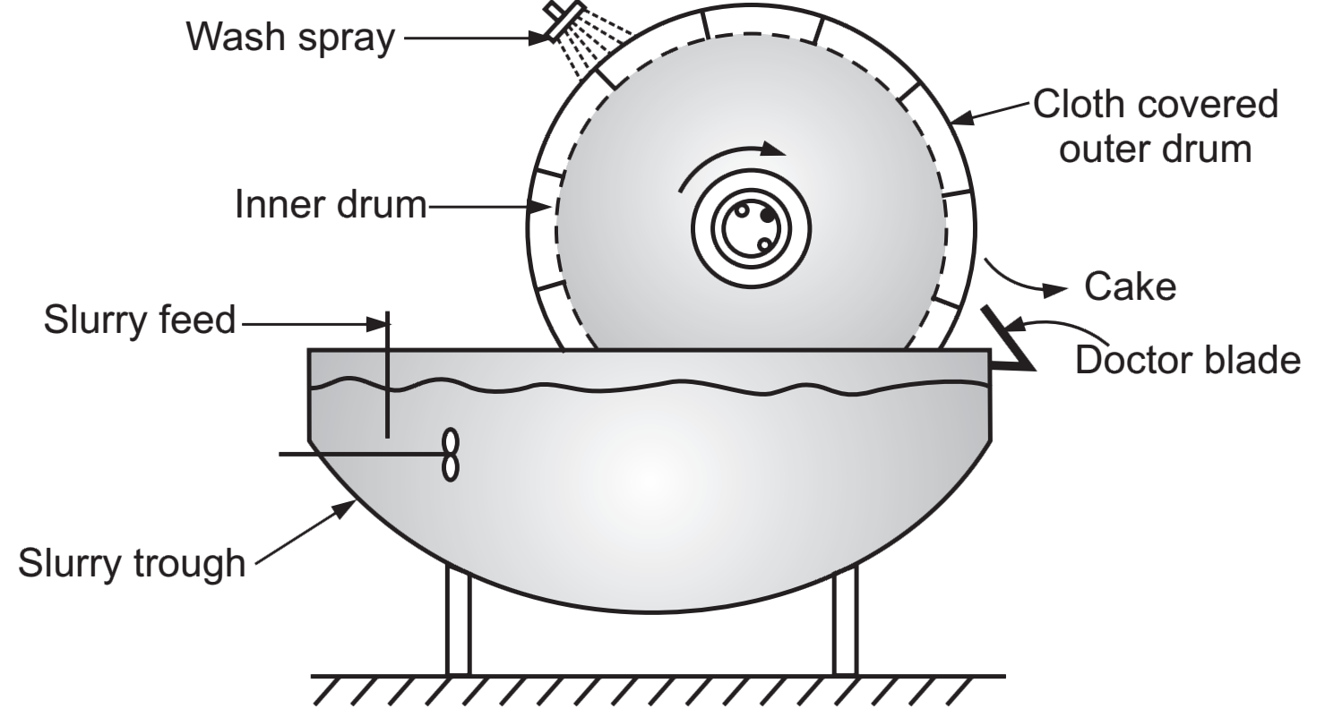
Continuous Filtration

Slide 6
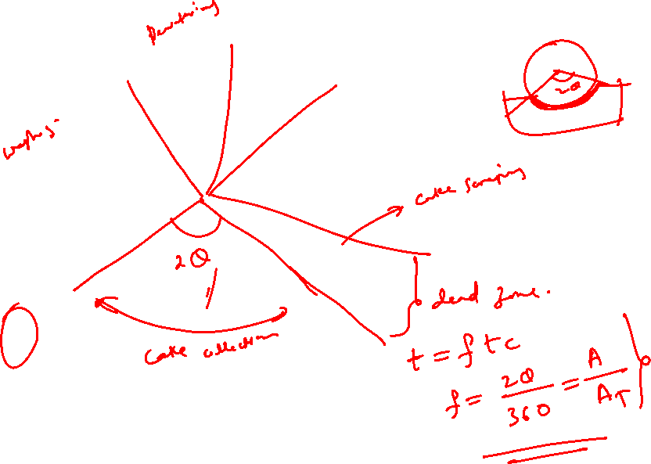
Continuous Filtration

Slide 7
Continuous Filtration
In a continuous filter (rotary-drum type) the feed, filtrate, and cake move at steady constant rates.
For any element of the filter surface conditions are not steady but transient.
The Process consists of several steps in series
  cake formation,
  washing,
  drying, and
  discharging
Each step involves progressive and continual change in conditions.
The pressure drop across the filter during cake formation is held constant.
Equations of discontinuous constant-pressure filtration with some modification may be applied to continuous filters.

Slide 8
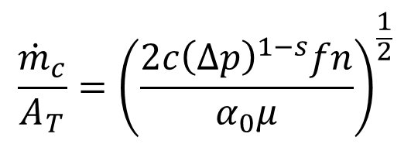
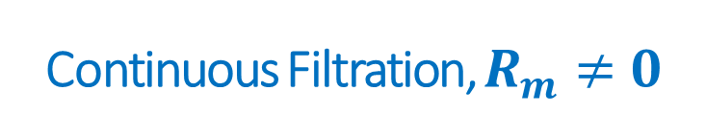
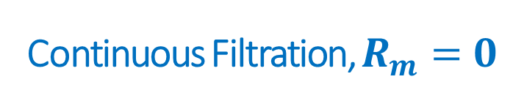
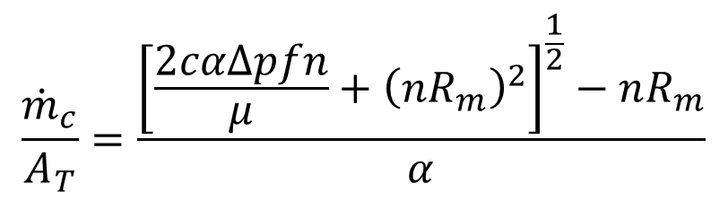
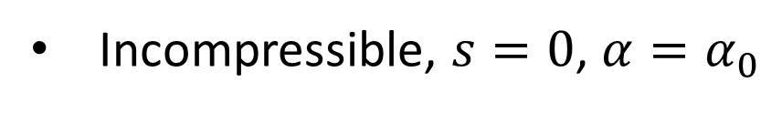
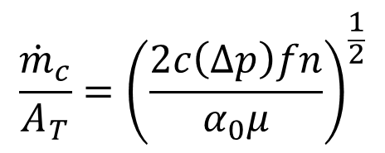
Continuous Filtration, $R_{m}=0$
SUMMARY OF DESIGN EQUATION FOR CONTINUOUS FILTRATION
For compressible
$$\frac{{\dot{m}}_{c}}{A_{T}}={\left(\frac{2c{\left(Δp\right)}^{1−s}fn}{α_{0}μ}\right)}^{\frac{1}{2}}$$
Incompressible, $s=0$, $α=α_{0}$
$$\frac{{\dot{m}}_{c}}{A_{T}}={\left(\frac{2c\left(Δp\right)fn}{α_{0}μ}\right)}^{\frac{1}{2}}$$
Continuous Filtration, $R_{m}≠0$
$$\frac{{\dot{m}}_{c}}{A_{T}}=\frac{{\left[\frac{2cαΔpfn}{μ}+{\left(nR_{m}\right)}^{2}\right]}^{\frac{1}{2}}−nR_{m}}{α}$$

Slide 9
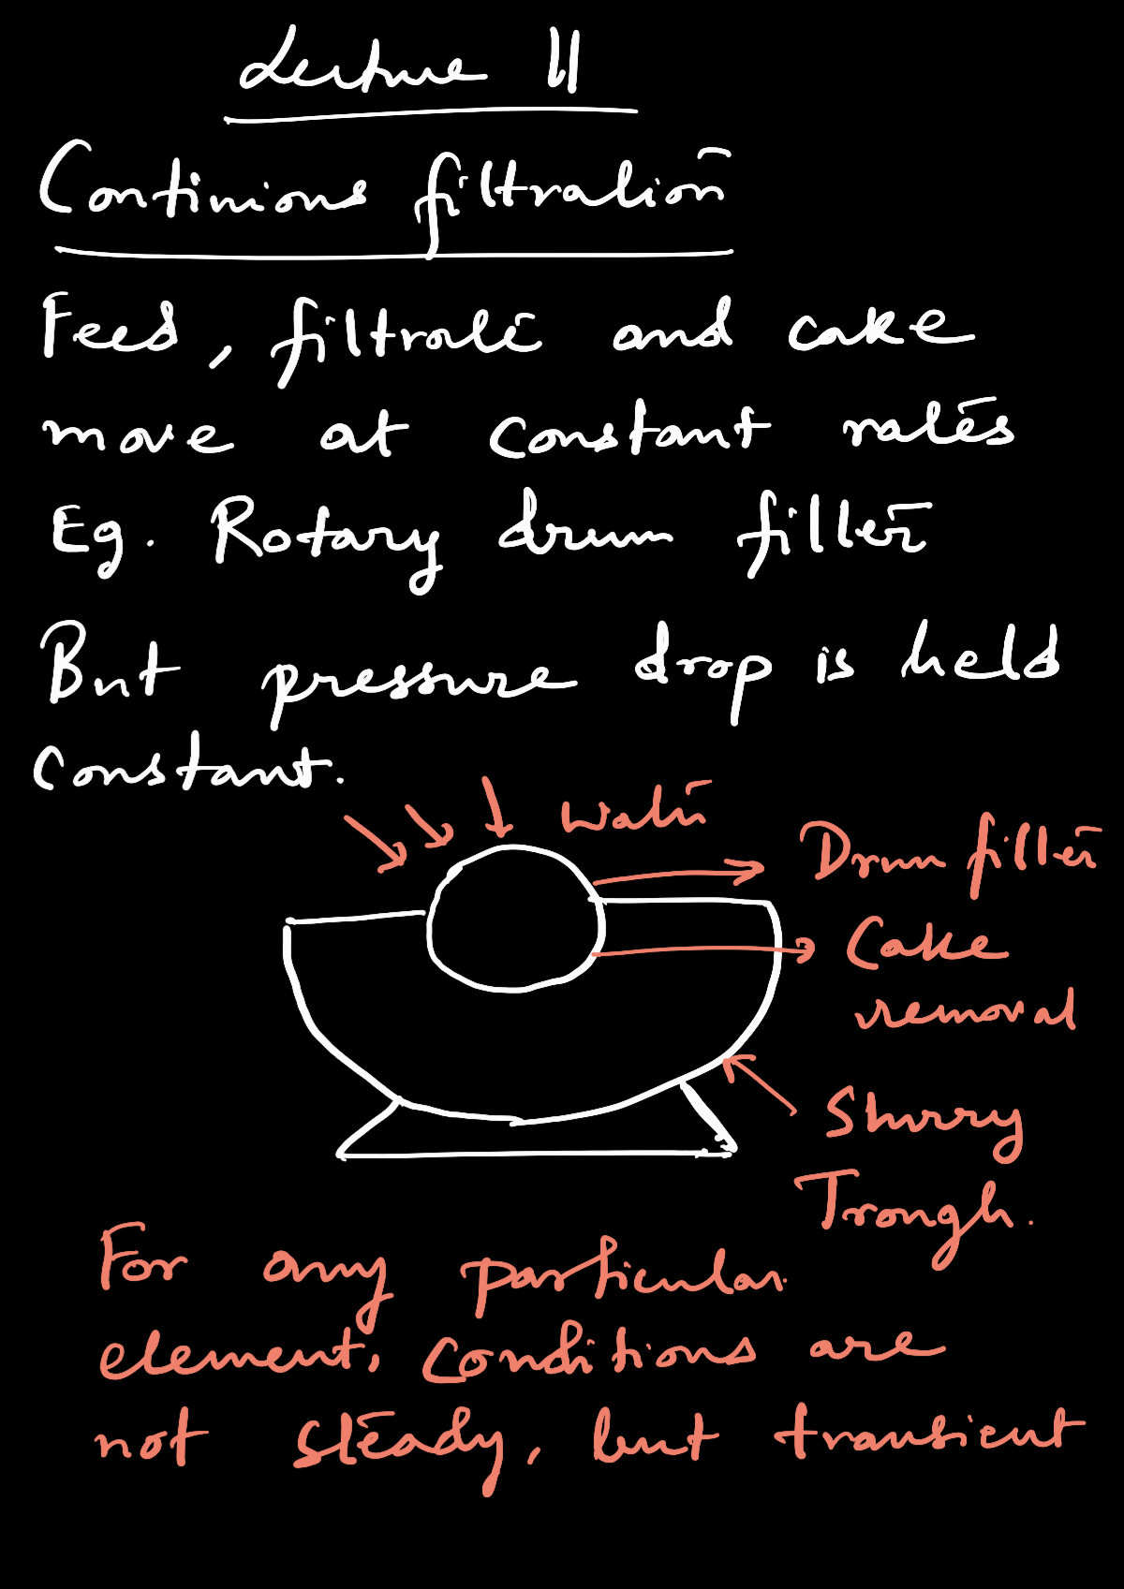


Slide 10


Slide 11


Slide 12


Slide 13


Slide 14


Slide 15


Slide 16


Slide 17



Continuous Filtration
For compressible
Final equation: $\frac{{\dot{m}}_{c}}{A_{T}}=\left(\frac{2c{\left(Δp\right)}^{1−s}fn}{α_{0}μ}\right)$
Incompressible, $s=0$, $α=α_{0}$
Final equation: $\frac{{\dot{m}}_{c}}{A_{T}}=\left(\frac{2c{\left(Δp\right)}^{1−s}fn}{α_{0}μ}\right)$

Slide 18
References
Smith, J., Harriott, P., McCabe, W. (2005). Unit Operations of Chemical Engineering. Colombia: McGraw-Hill Education.
Swain, A. K., Patra, H., & Roy, G. K. (2011). Mechanical operations. Tata McGraw Hill.

